Slide 1
AGILE MODEL by -Niteesh Kumar-

Slide 2

Contents
Methodology
Roles in agile
Advantages and Disadvantages
Principles of Agile Manifesto
Characteristics
Scrum
Principles of Kandan
Extreme Programming
Principles and Values of Extreme Programming.

Slide 3

AGILE METHODOLOGY
The Agile methodology is a way to manage a project by breaking it up into several phases.
It involves constant collaboration with stakeholders and continuous improvement at every stage.
Once the work begins, team cycle through a process of planning, executing, and evaluating.

Slide 4
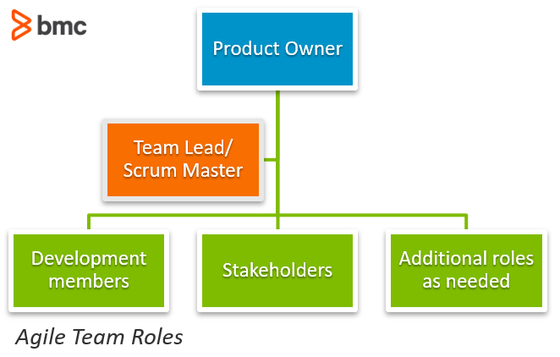
Roles in Agile

Slide 5
Advantages And Disadvantages of Agile
Advantages
Flexibility and Adaptability
Creativity and innovation
Time-to-Market
Lower costs
Improved quality
Disadvantages
Skill Required
Organizational transformation
Project Management
Scalability
Integration with Project

Slide 6

Principles of Agile manifesto
The Key Values and Principles of the Agile Manifesto
Individuals and interactions over processes and tools.
Working software over comprehensive documentation.
Customer collaboration over contract negotiation.
Responding to change over following a plan.

Slide 7

Agile characteristics
Fast Delivery Times
Continuous Adaptation
Focus on Collaboration.
Greater Transparency. ...
Test Early and Often. ...
One Step at a Time. ...
Self-Motivated Workforce.

Slide 8

scrum
In short, scrum is a framework for effective collaborations among teams working on complex products.
Scrum is a type of agile technology
It consists of meetings, roles, and tools to help teams working on complex projects collaborate and better structure and manage their workload.

Slide 9
Principles of KANDAN
Overview
Kandan is a highly visual work management method, developed in Japan in the late 1940’s by Toyota engineers.
The word Kandan roughly translates in Japanese as “visual card”.
Four main principles of Kandan.
Visualize workflow
Limit work in progress (WIP)
Focus on flow
Continuous improvement

Slide 10

Extreme programming
XP is built upon values, principles, and practices, and its goal is to allow small to mid-sized teams to produce high-quality software and adapt to evolving and changing requirements.

Slide 11
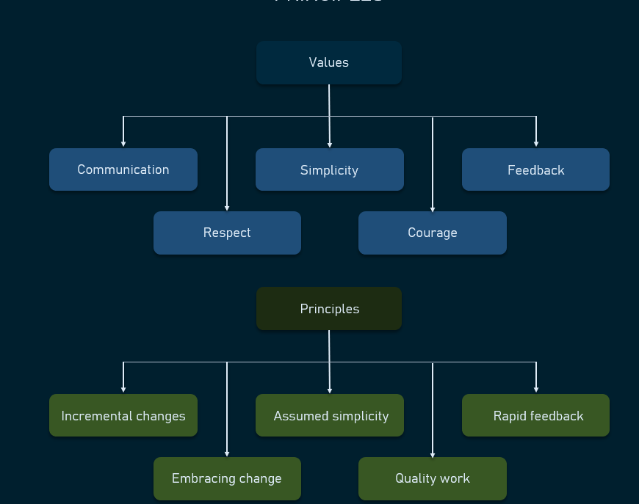
Principles and values of extreme programming
Software engineer ken Beck introduced XP in the 90s.
The goal of finding ways to write high-qualitative software quickly and being able to adapt to customers’ changing requirements.
In 1999, he refined XP approaches in the book Extreme programming

Slide 12
Thanks

